Slide 1


PRESENTATION
UX/UI audit, sitemap and architecture
SpareRoom rebrand · spareroom.co.uk
04/10/2026
By Mayare Ouassou

Slide 2
Contents
1
Objectives
2
UX/UI audit synthesis
3
Sitemap and architecture
By Mayare Ouassou

Slide 3
1
Objectives
By Mayare Ouassou

Slide 4
1
Objectives
Objectives of the redesign
→ Show who lives there: every room introduces the current flatmates before the property. That's the "Know who you'll live with" promise.
→ Let people write for free: a seeker can contact any listing without paying or filling ten fields before their first message.
→ Sort what you find: a room search shows rooms in shared homes, not whole houses or agency studios.
→ Make safety visible: ID checks, advice and alerts at the moment they matter: message, viewing, deposit.
→ Leave no one without an answer: reply times shown, explicit refusals, alternatives offered when a room goes.
By Mayare Ouassou

Slide 5
1
Objectives
Scope and method
→ Method: expert review of the live site, Bastien & Scapin ergonomic criteria, plus specific and complementary criteria.
→ Devices: desktop 1440 px and mobile 390 px (m.spareroom.co.uk).
→ Journeys audited: finding a room (home, results, listing, message) and filling a room (posting an ad).
→ Conditions: logged-out visitor, no account created, no form submitted. The logged-in area is out of scope.
→ Related deliverable: Audit grid (Excel), 46 findings with screenshots and recommendations.
46
6
findings
critical
17
10
major
minor
10
3
positive
informative
By Mayare Ouassou

Slide 6
2
UX/UI audit synthesis
By Mayare Ouassou

Slide 7
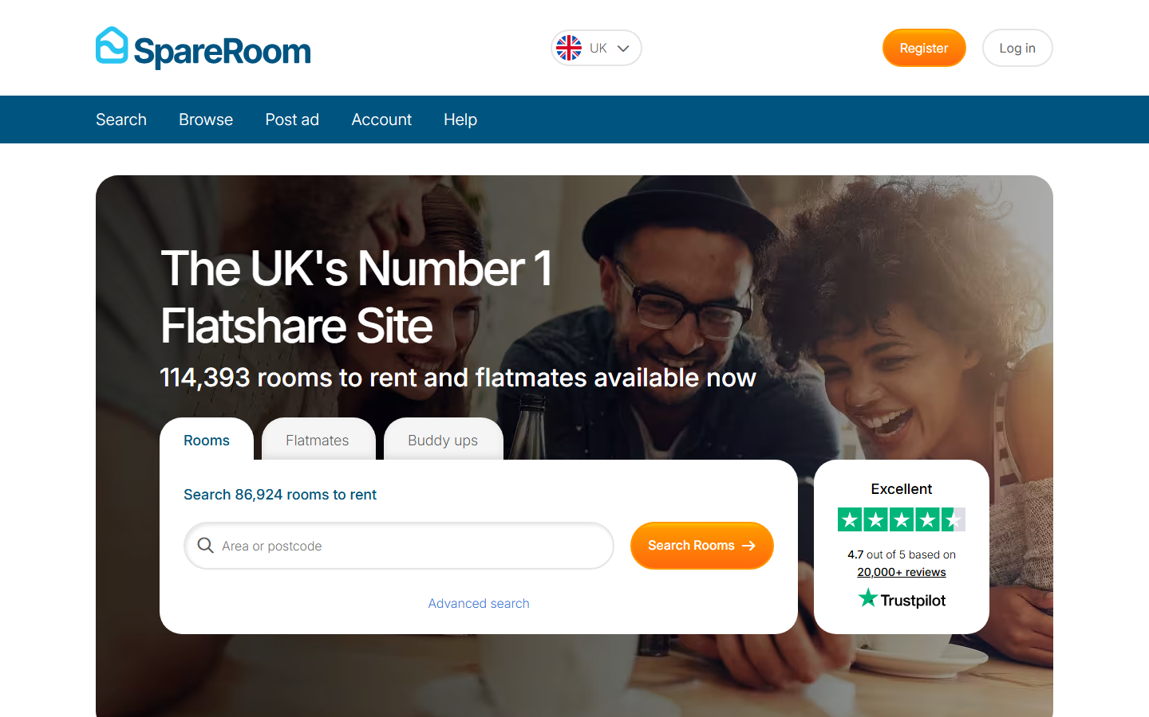
2
UX/UI audit synthesis
Home page
→ A promise centred on the platform: "The UK's Number 1 Flatshare Site" says nothing about what the person came for.
→ Three tabs with no explanation: "Rooms", "Flatmates", "Buddy ups". The last one is an in-house term nobody understands on a first visit.
→ "We're all about people" comes third, with no proof at all.
→ What works: a single search field at the centre, and the Trustpilot rating visible straight away.
→ The brand's human content (Home Again podcast, Crisis partnership) is buried at the bottom of the page.
Current site screenshot · 01_home_desktop
By Mayare Ouassou

Slide 8
!
Recommendations · Home page
→ Replace the headline with a promise of use: "Find a room, and meet who lives there first".
→ Entries written as verbs: "I need a room", "I have a room to fill", "Find people to rent with".
→ Keep the single search at the centre; Trustpilot proof as a second level.
→ Make people the first argument, with a real excerpt from "Who lives here".
→ Merge "Search" and "Browse" in the header; offer the app after a first search, not on arrival.
By Mayare Ouassou

Slide 9
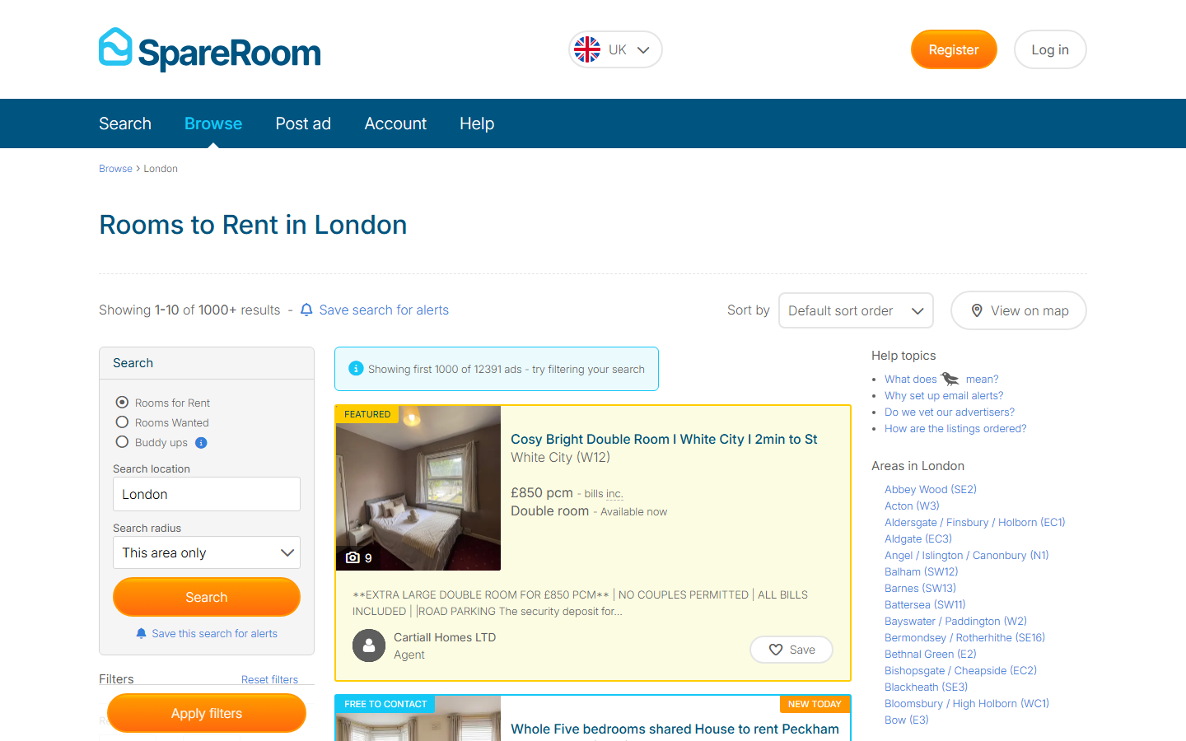
2
UX/UI audit synthesis
Search results
→ You don't find what you searched for: "Rooms to Rent in London" mixes rooms, whole houses at £4,395 and agency studios.
→ Badges with no legend: "Featured", "Boosted", "Free to contact". The last one hints that the other ads are paid.
→ The first result is a sponsored agency ad, on a yellow background.
→ Contradictory counters: "1000+ results" then "first 1000 of 12391 ads".
→ No information about current flatmates on the cards. Only the advertiser's role is shown, which is a good starting point.
Current site screenshot · 02_results_london_desktop
By Mayare Ouassou

Slide 10
!
Recommendations · Search results
→ Show rooms in shared homes by default; whole properties in a separate tab.
→ Remove commercial badges on the seeker side, or explain them plainly.
→ Flag sponsored content and never place it at the top of a room search.
→ An exact counter ("12,391 rooms in London") and a named sort.
→ Add to every card: "Lives here: 2 people, 26-31, professionals" and the verified badge.
By Mayare Ouassou

Slide 11
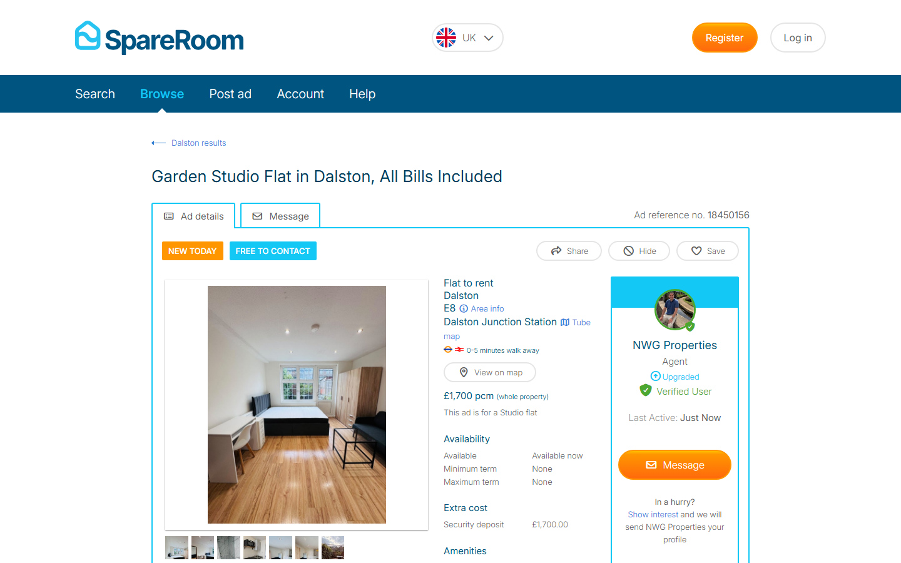
2
UX/UI audit synthesis
Listing
→ No section about the people who live there: you learn about the parking and the garden, not the flatmates.
→ The essentials drowned in some twenty yes/no attributes: "Living room: No" sits at the same level as "Garage".
→ Ads in capitals asking for age, salary and status in public: nothing frames how ads are written.
→ What works: "Verified user" (photo ID, email, mobile) and the response rate exist, but at the bottom of the page.
→ A promoted ad suggests carrying on over WhatsApp, the opposite of the site's own safety advice.
Current site screenshot · 03c_listing_private_desktop
By Mayare Ouassou

Slide 12
!
Recommendations · Listing
→ Open the listing with "Who lives here": first names, ages, routines, one line each, verified status.
→ A summary of the 4 deciding facts at the top: living room, bathroom, number of flatmates, bills.
→ Structure the ad into guided fields and publish writing rules.
→ Move verification and "Usually replies within a day" next to the contact button.
→ Detect invitations to leave the platform and warn the reader.
By Mayare Ouassou

Slide 13
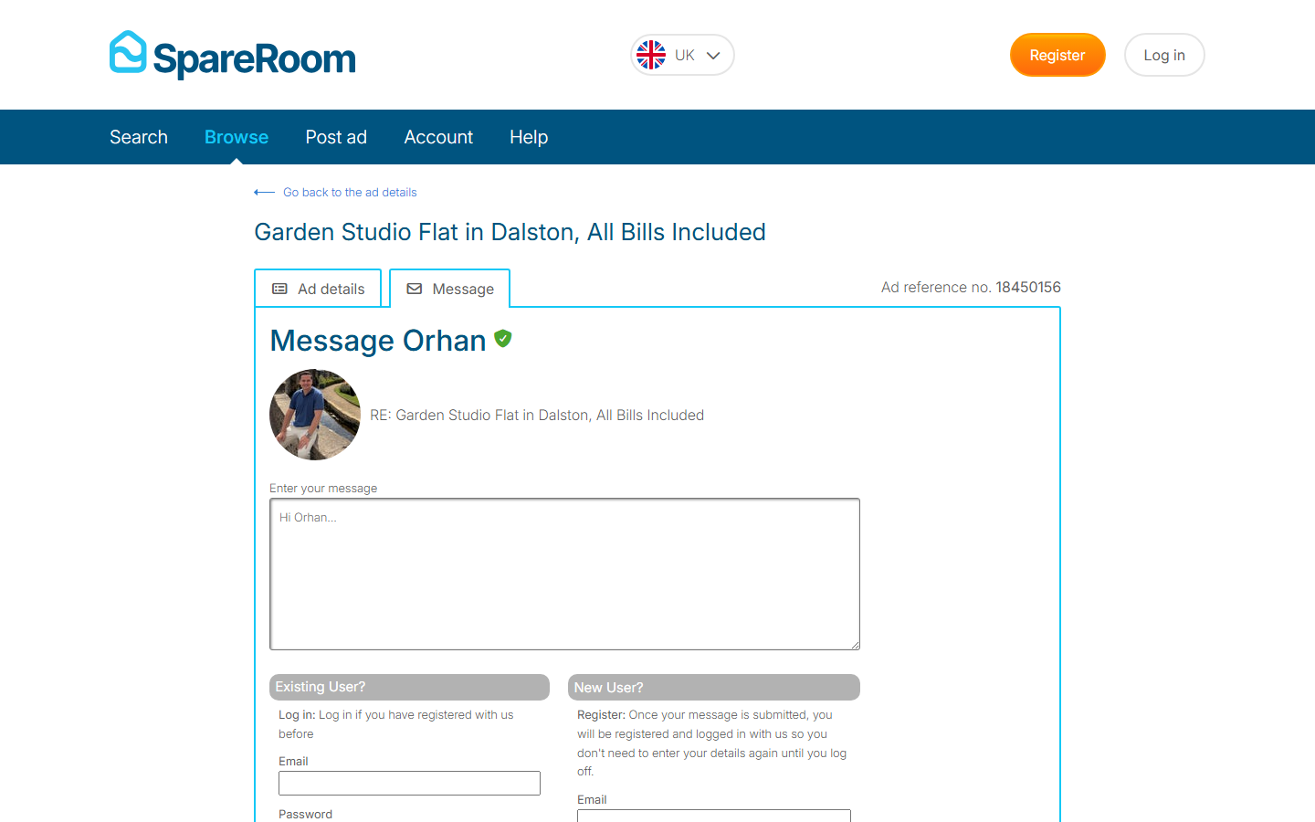
2
UX/UI audit synthesis
Contacting an advertiser
→ The sign-up wall: clicking "Message" opens a page mixing login and full registration before you can send a single word.
→ The hidden paid rule: Early Bird stops free accounts from contacting ads younger than 7 days. You have to pay £15 to £149.
→ You learn the rule when you try to write, and the FAQ explains it with internal jargon ("Bold Ads", grey and blue ads).
→ No signpost after sending: reply time, what to do if nobody answers.
→ The reviews confirm it: "they block viewers because they want to force them to […] Pay £4.99" (Trustpilot review, Sept. 2026).
Current site screenshot · 03d_message_desktop
By Mayare Ouassou

Slide 14
!
Recommendations · Contacting an advertiser
→ Write first, create the account afterwards, in one step (email + first name, or Google / Apple).
→ Make contact free for seekers and monetise on the advertiser side (promotion, sorting tools).
→ Failing that, announce the rule on the results list, in one clear sentence.
→ After sending: "Orhan usually replies within a day. We'll tell you if the room goes."
→ Measure drop-off between clicking "Message" and the first message sent.
By Mayare Ouassou

Slide 15
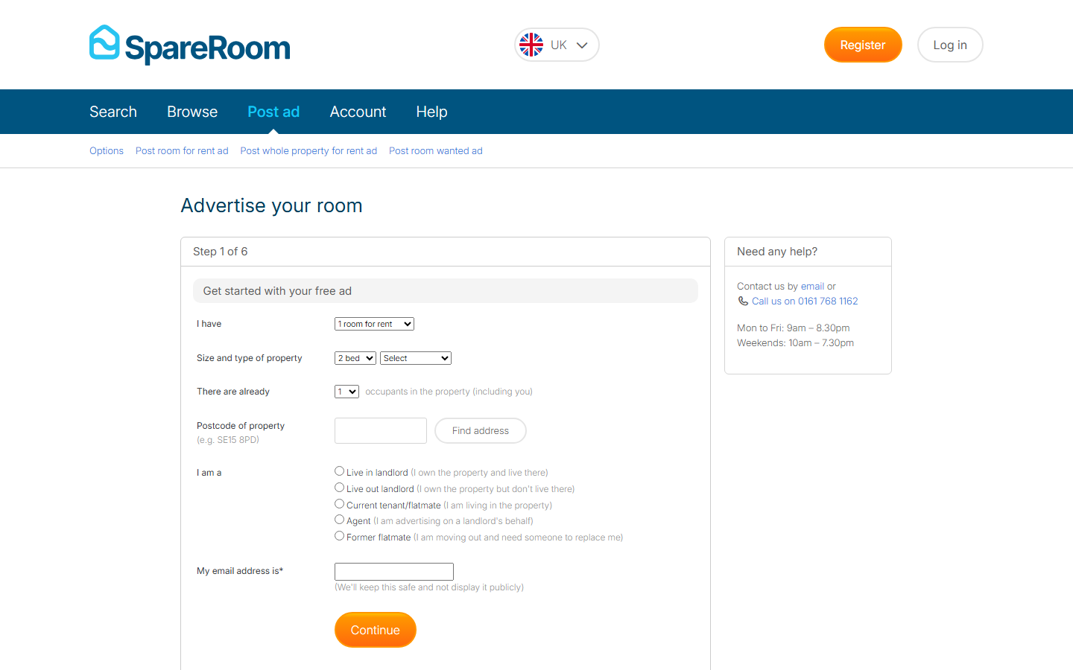
2
UX/UI audit synthesis
Posting an ad
→ Six steps to list a room, with native dropdowns from 1 to 12.
→ Occupants are counted ("There are already … occupants") but never introduced.
→ "Buddy ups" is only a checkbox, explained in small print, in the room-wanted ad.
→ On mobile, the form keeps the desktop's dropdowns and narrow fields.
→ What works: the choice page clearly separates room, whole property and room wanted.
Current site screenshot · 06b_post_ad_step1_desktop
By Mayare Ouassou

Slide 16
!
Recommendations · Posting an ad
→ Three steps: the home, the flatmates, the room.
→ A "Who lives here" step: a mini profile for each flatmate, with their consent.
→ Make "find people to rent with" an entry in its own right, from the home page.
→ A form designed for mobile first: one field per screen, photos straight from the device.
→ Show a preview of the result card before publishing.
By Mayare Ouassou

Slide 17
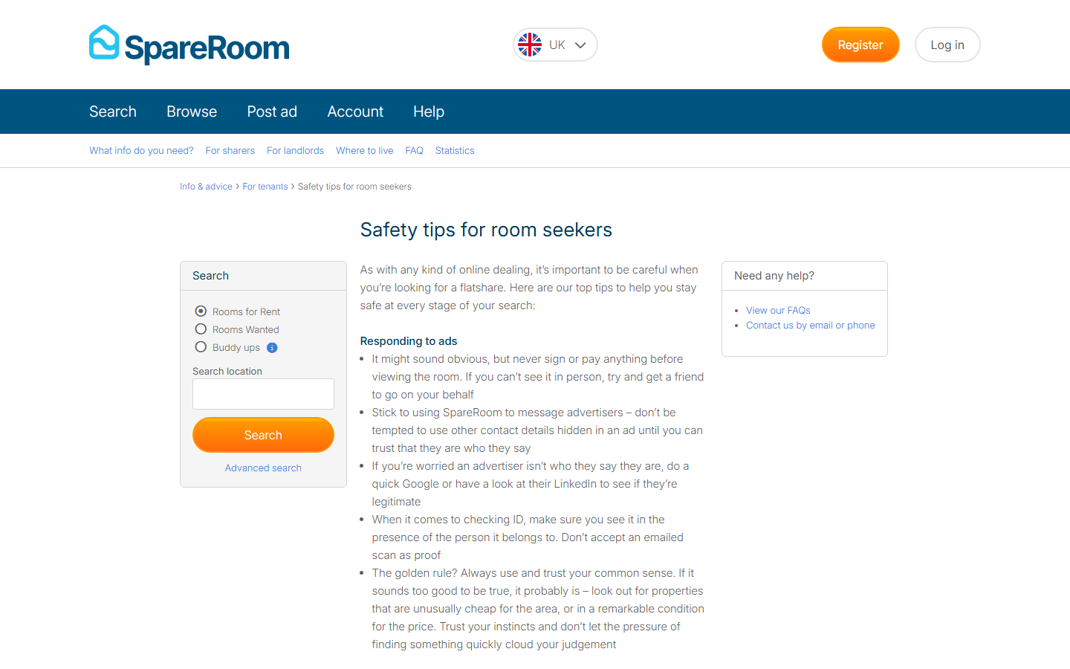
2
UX/UI audit synthesis
Safety and trust
→ The right content in the wrong place: the "Safety tips for room seekers" guide is thorough, but only reachable through a "See more" link.
→ Moderation isn't highlighted, and SpareRoom says so itself: "one of the things we don't shout about as much as we should".
→ Sign-up asks for gender and date of birth without explaining why.
→ "Show interest" sends the profile without saying what is shared.
→ The number one fear in the reviews (losing a deposit) has no visible answer in the journey.
Current site screenshot · 07_safety_desktop
By Mayare Ouassou

Slide 18
!
Recommendations · Safety and trust
→ Create a "How we check" entry in the header.
→ Split the guide into contextual tips: at the first message, before the viewing, before the deposit.
→ Show ID verification on every person, wherever they appear.
→ Explain in one line what each sensitive piece of data is used for.
→ List what is shared before any profile is sent, and let people choose.
By Mayare Ouassou

Slide 19
2
UX/UI audit synthesis
Proposed features
Six features that don't exist on the site today, each one answering a critical finding of the audit.
Who lives here
Every listing introduces the current flatmates: first name, age, routine, one line, verified status.
The "you and them" pair
The match lights up when both say yes: nobody is ignored in silence.
The 6-step gauge
Search, message, video call, viewing, agreement, move-in: you always know where you are.
Free contact
Seekers can write to every listing; monetisation moves to the advertiser side.
Fair rent
Every listing places its price against the area's Rental Index: "about average for Hackney".
Safety at the right time
Contextual reminders at the first message, before the viewing and before the deposit; an alert if someone suggests leaving the site.
By Mayare Ouassou

Slide 20
3
Sitemap and architecture
By Mayare Ouassou

Slide 21
3
Sitemap and architecture
Header
→ SpareRoom logo: → home page
→ Find a room: → results, rooms in shared homes by default
→ Fill a room: → post an ad in 3 steps
→ How we check: → verification, advice, fair rent
→ Log in: → account, messages, alerts (once logged in, Messages replaces Log in)
Four entries, one main action
Today's header lines up Search, Browse, Post ad, Account and Help, even for a logged-out visitor. Search and Browse lead to the same need.
We keep the two real intentions (searching, offering) and add trust, which answers users' first fear.
By Mayare Ouassou

Slide 22
3
Sitemap and architecture
Footer
Search and offer
Find a room
Find people to rent with
Fill a room
Rooms by city
Rental Index
Trust and help
How we check
Safety tips
Fair rent guide
Help centre
Contact us
About
About SpareRoom
Home Again podcast
Partnership with Crisis
Press
Jobs
Bottom bar: logo, social links, legal notice, privacy, accessibility. From more than 40 links in 7 columns down to 3 readable columns; city pages stay available for search engines.
By Mayare Ouassou

Slide 23
3
Sitemap and architecture
Page architecture
Entry
· Home
· Search by area
· Rooms by city (SEO)
Search
· Results: list + map
· Listing: Who lives here
· Email and mobile alerts
Meet
· Message with no sign-up wall
· The "you and them" pair
· Video call, viewing
Offer
· Post in 3 steps
· Introduce the flatmates
· Find people to rent with
Trust
· How we check
· ID verification
· Fair rent, advice
Account (optional)
· Created at the first message
· Messages, alerts
· Published ads
Rule applied: no page that doesn't serve a step of the two journeys (finding a room, filling a room).
By Mayare Ouassou

Slide 24
3
Sitemap and architecture
The sitemap
Home
Search
Meet
Offer
Trust
Results: list + map
Message (free)
Post in 3 steps
How we check
Rooms in shared homes
"You and them" pair
Introduce the flatmates
ID verification
Whole properties
Video call
Find people to rent with
Fair rent
Listing: Who lives here
Viewing and agreement
Manage replies
Safety tips
Out of the sitemap: commercial badges on the seeker side, paying to contact (Early Bird), the "Browse" tab, a separate mobile site, sign-up before the first message.
By Mayare Ouassou

